Slide 1
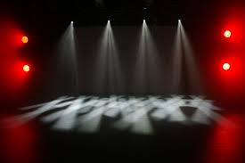
Theatrical lighting design (in 20 minutes)
15/03/21
Jo Howcroft
j.howcroft@wimbledon.arts.ac.uk

Slide 2
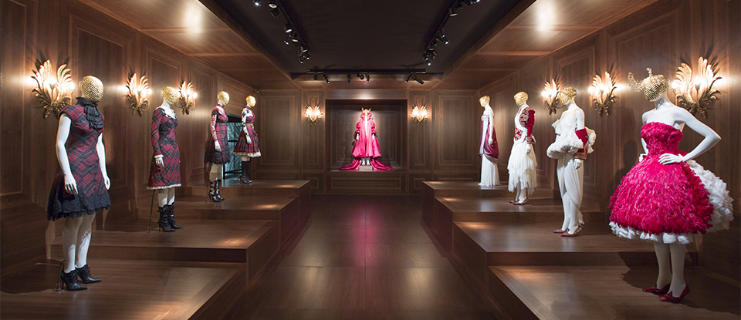
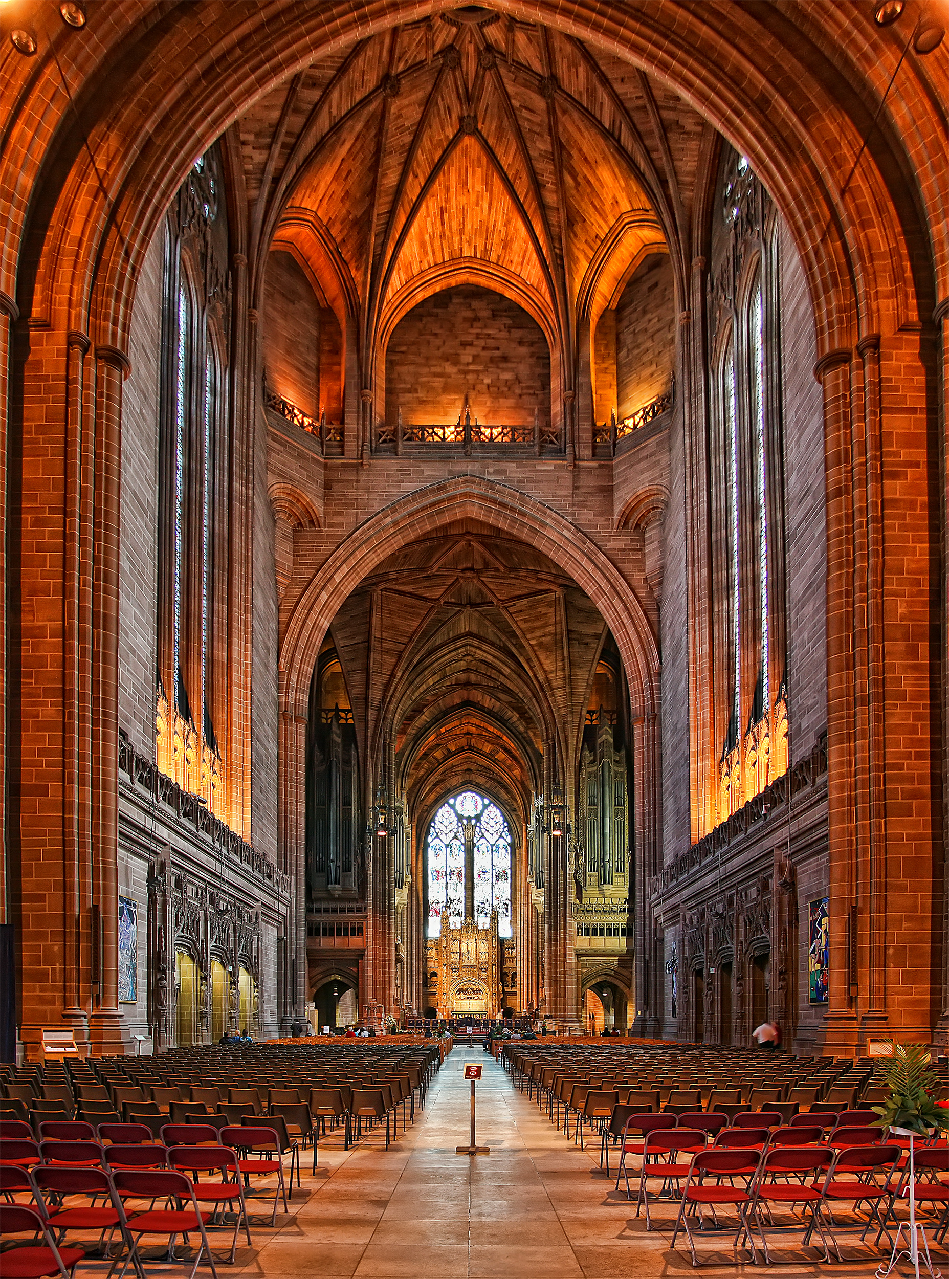
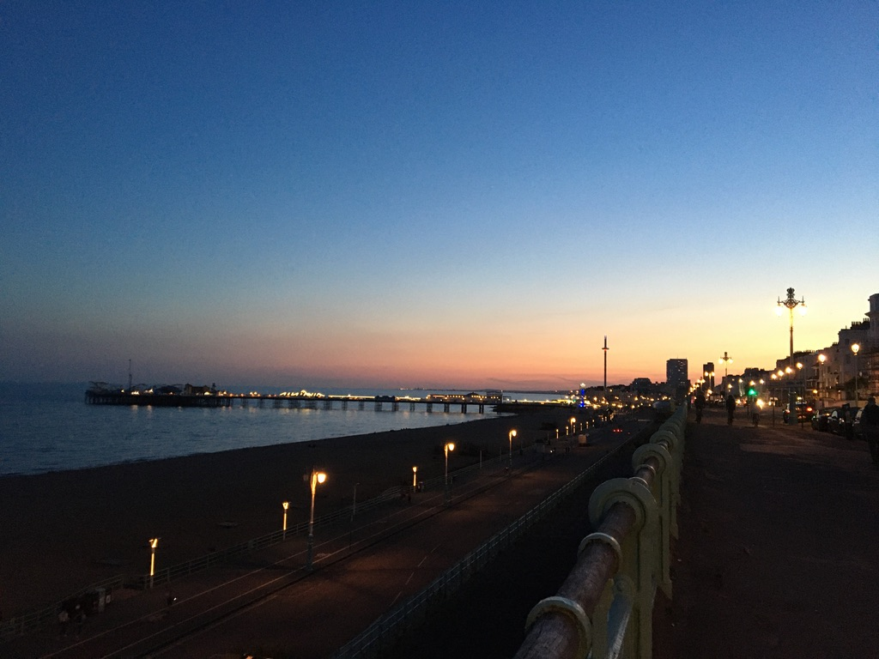
Impactful spaces
V&A Alexander McQueen: Savage Beauty exhibition
Sunset over Brighton pier
Liverpool Cathedral

Slide 3
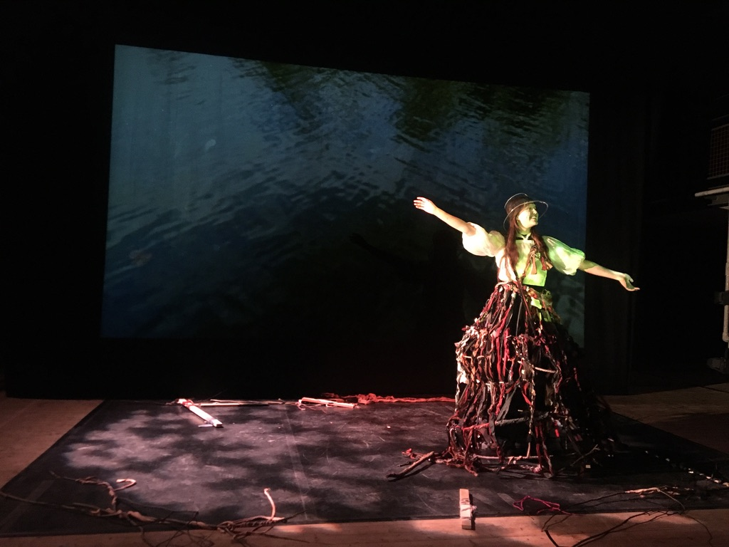
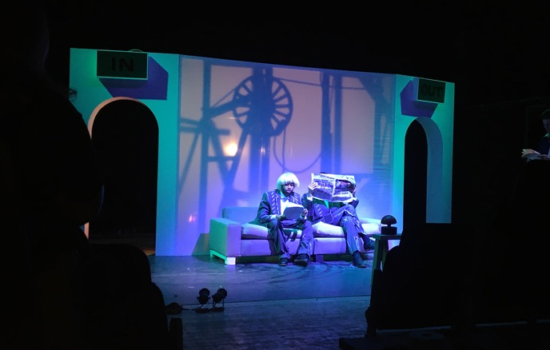
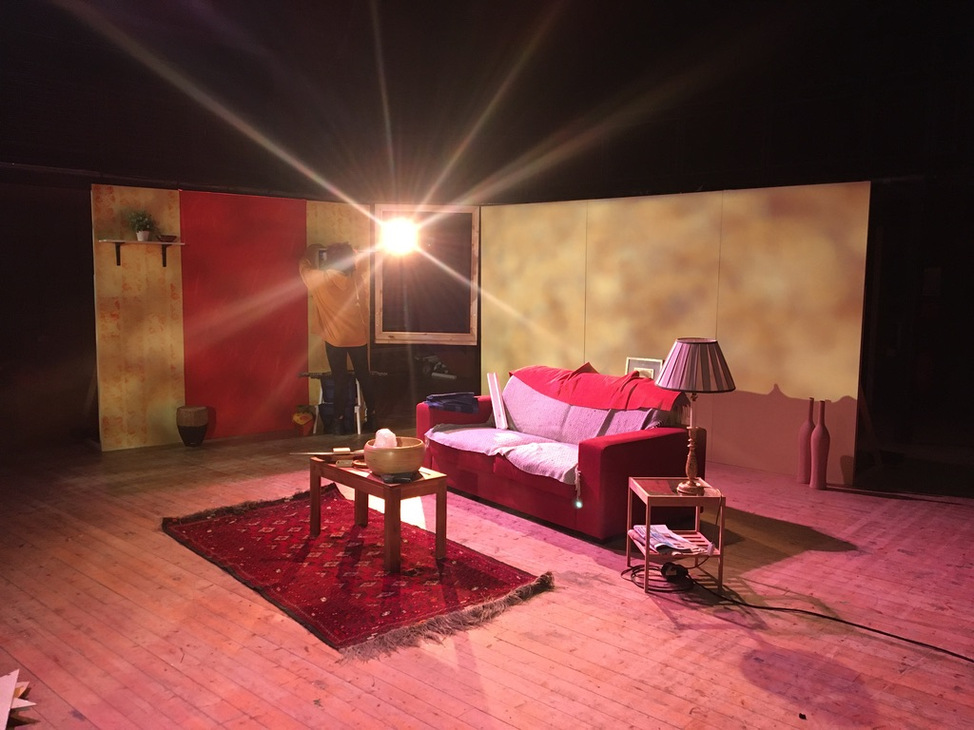
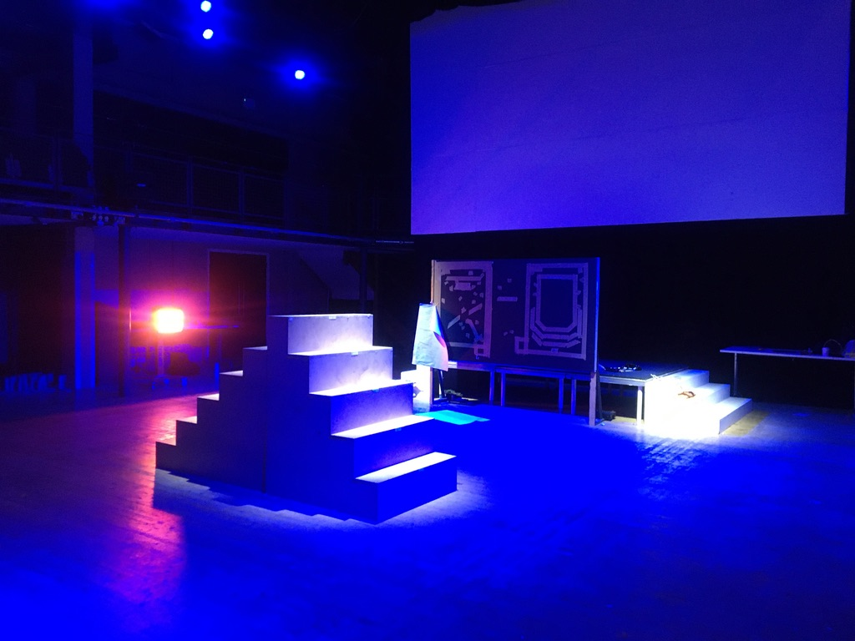
What is the purpose of lighting design?
Illumination - performers
Depth
Illumination - set
Focus attention and emotion

Slide 4
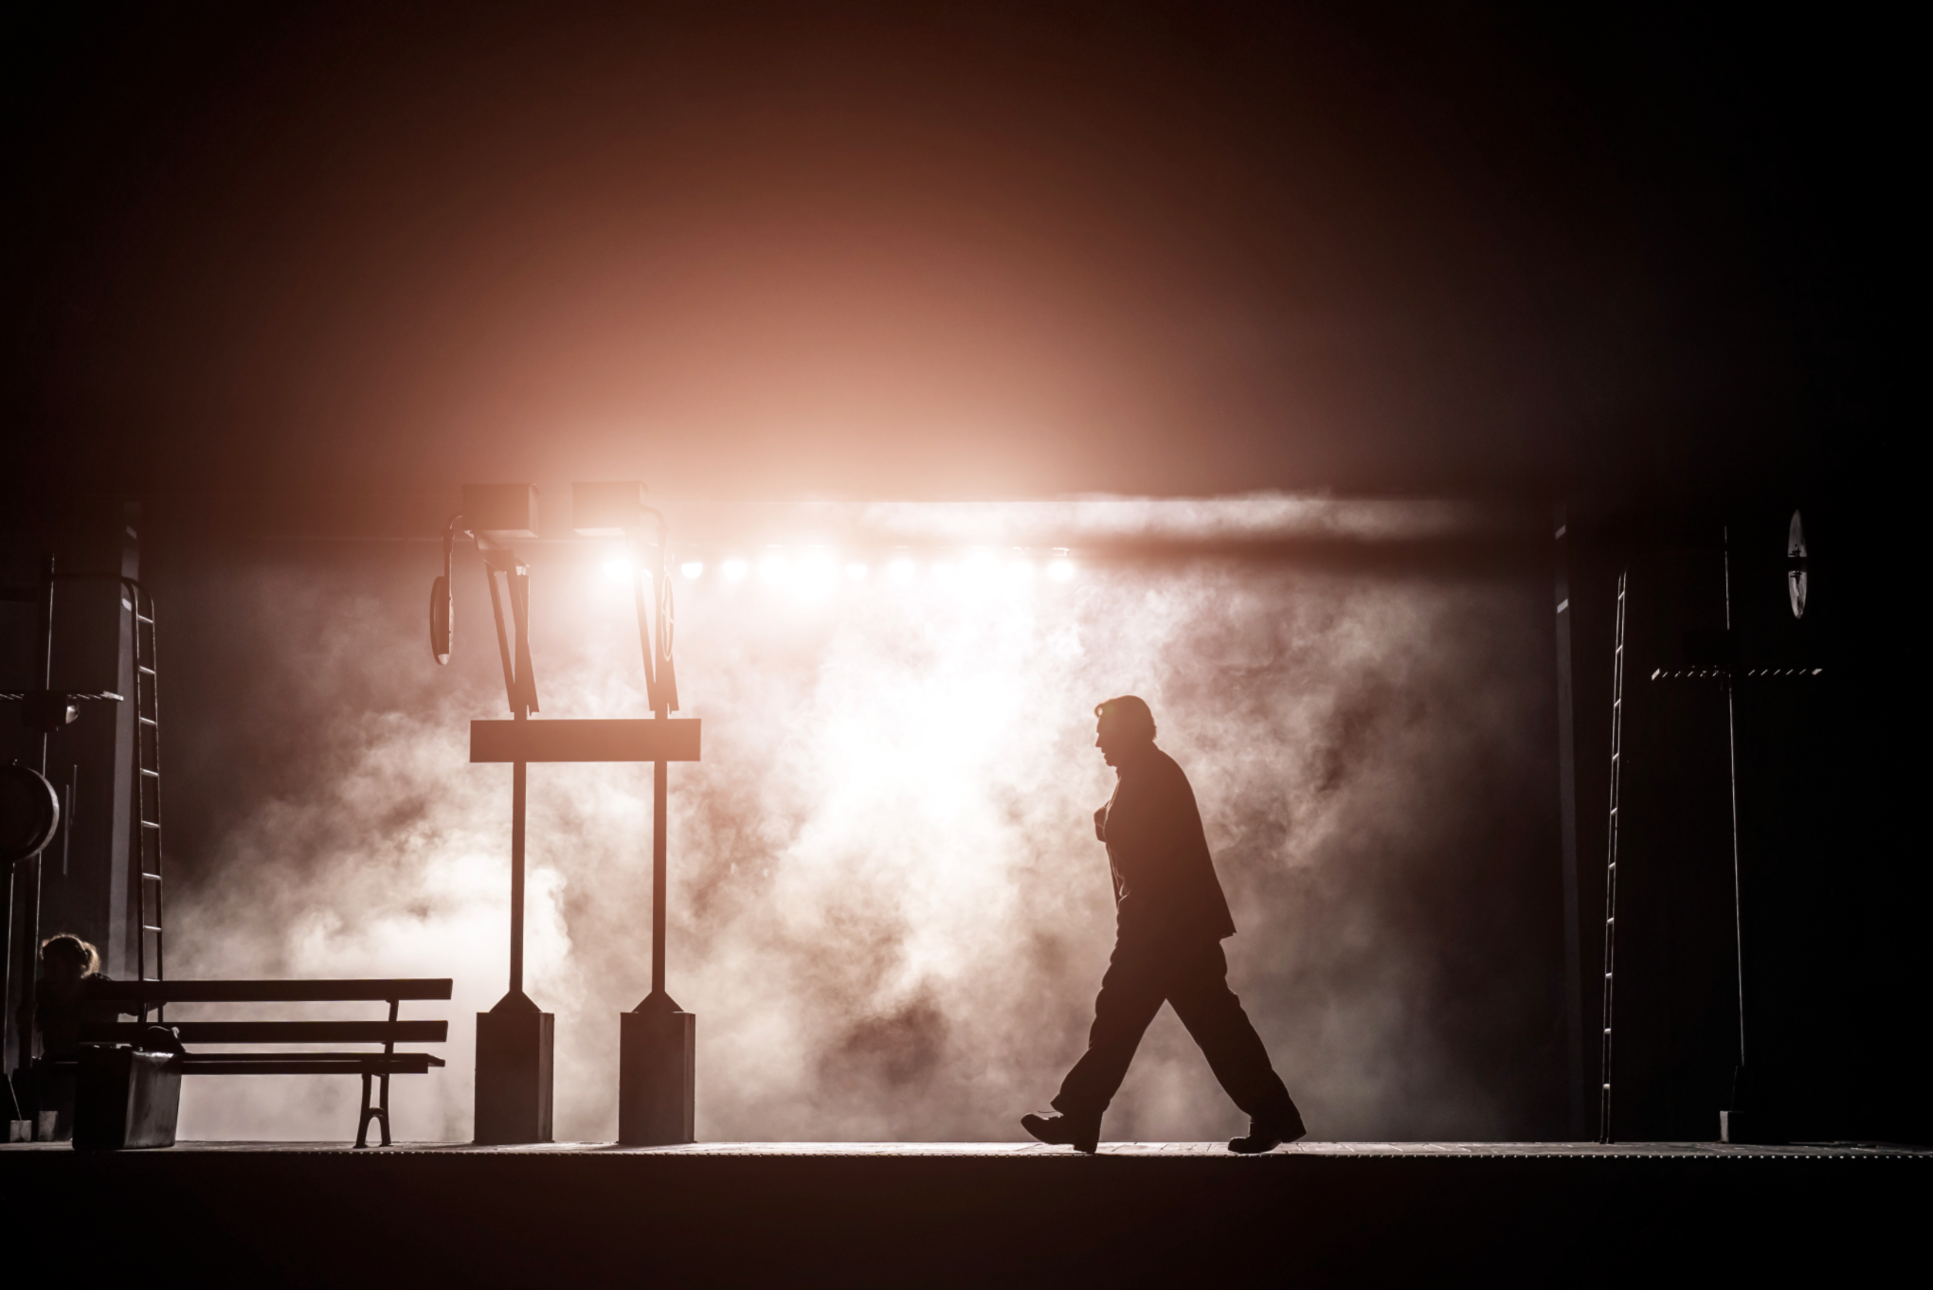
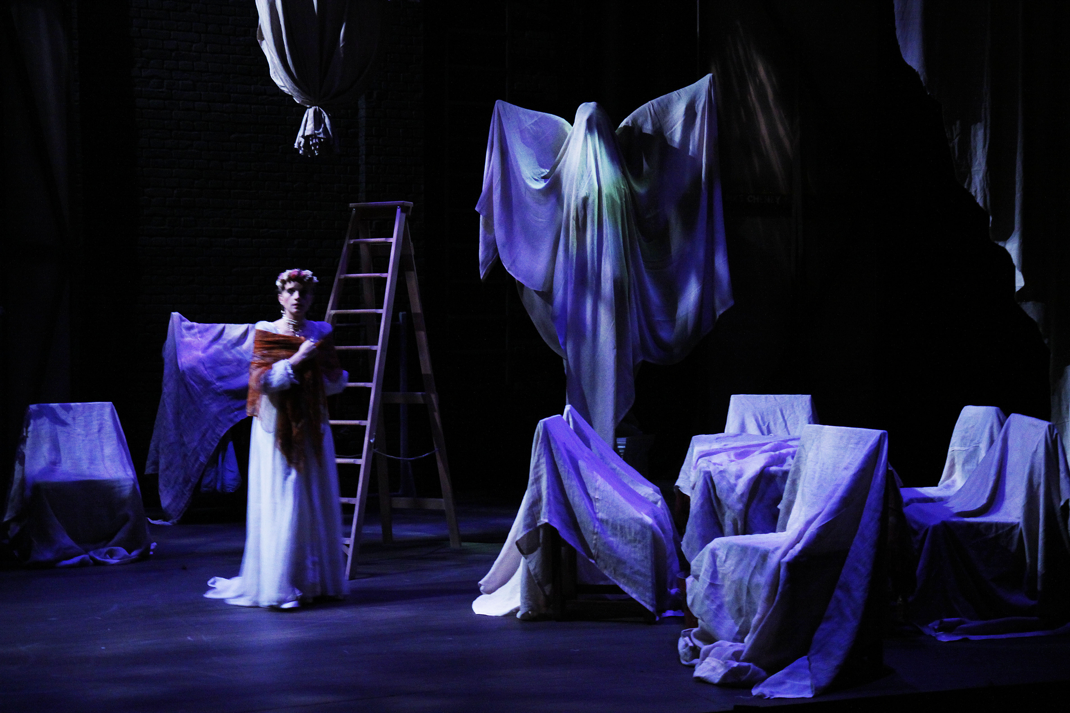
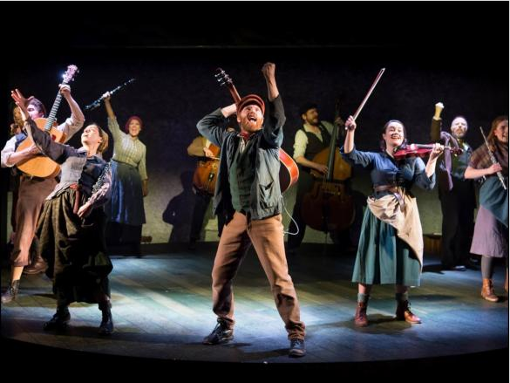
Emotional responses
to aid narrative
Colour
Texture
Direction
Strength
The Visit
Lighting: Paule Constable
A Murder Has Been Arranged
Lighting: Chris Howcroft
The Hired Man
Lighting: Prema Mehta

Slide 5
When different lighting conditions are created, what is the emotional response?
How does this aid the narrative arc of the story?

Slide 6
Task
https://artslondon.padlet.org/jhowcroft/3bhziycan2ly8ud
Step 1: Put your chosen object on your desk or table. Photograph it under room lighting/natural lighting
Step 2: Gather your light source. This may be a torch, Anglepoise lamp, a separate phone torch to your digital camera
Step 3: Darken your room or go to a room you can darken.
Step 4: Investigate your object under your artificial lighting, highlighting the object from different angles and distances (for brightness)
Consider – emotions/moods/adjectives and how they may relate to the different looks produced.
Step 5: Take a photograph of one example of your investigations
Step 6: Upload to padlet your base ‘room/natural lighting’ photograph and your theatrical lighting photograph (you can upload from your smartphone or transfer your file to your computer to upload)
8 minutes for the task (including uploading) 5 minutes will follow for a discussion

Slide 7
Stay in the Collaborate Ultra room.
I will be available in case you have any questions about the task
Keep mics off
I will play music to indicate 8 minutes are over
We will meet promptly back in the Collaborate Ultra room to discuss the task
8 minutes start now!

Slide 8
Task
https://artslondon.padlet.org/jhowcroft/3bhziycan2ly8ud
Step 1: Put your chosen object on your desk or table. Photograph it under room lighting/natural lighting
Step 2: Gather your light source. This may be a torch, Anglepoise lamp, a separate phone torch to your digital camera
Step 3: Darken your room or go to a room you can darken.
Step 4: Investigate your object under your artificial lighting, highlighting the object from different angles and distances (for brightness)
Consider – emotions/moods/adjectives and how they may relate to the different looks produced.
Step 5: Take a photograph of one example of your investigations
Step 6: Upload to padlet your base ‘room/natural lighting’ photograph and your theatrical lighting photograph (you can upload from your smartphone or transfer your file to your computer to upload)
8 minutes for the task (including uploading) 5 minutes will follow for a discussion

